Slide 1
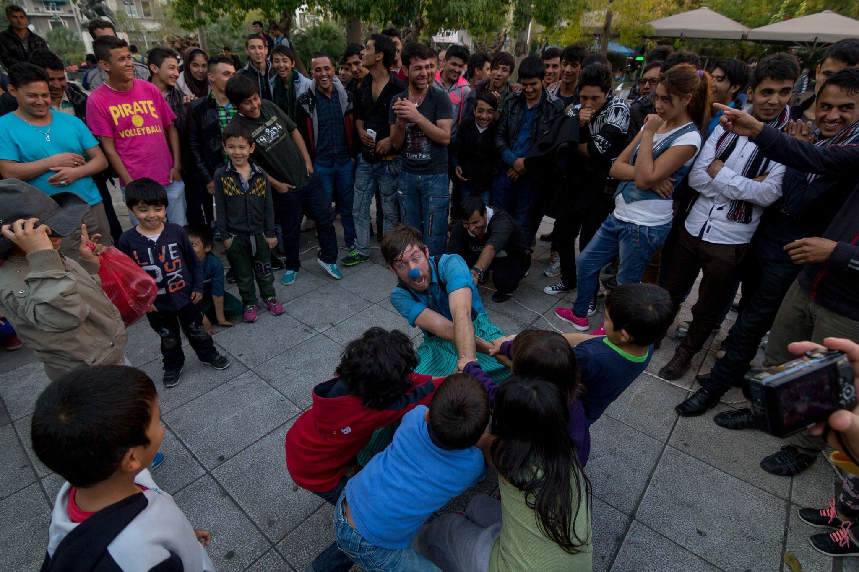
Clowning between drowning and hope
Clay mazing

Slide 2
Pie chart
Not Ate
Ate
Mmmm Pie

Slide 3
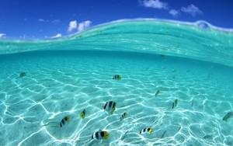
Ocean picture

Slide 4
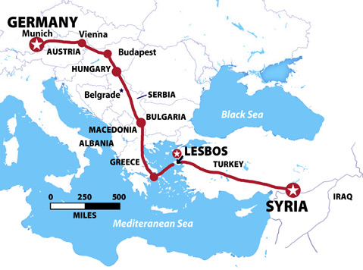
Turkey Syria map

Slide 5
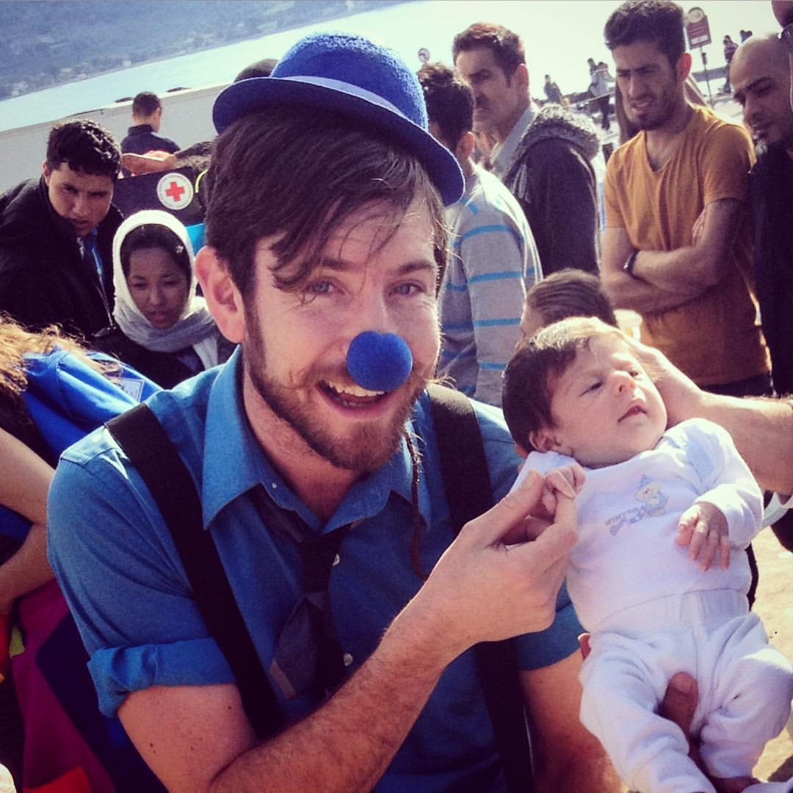

Slide 6
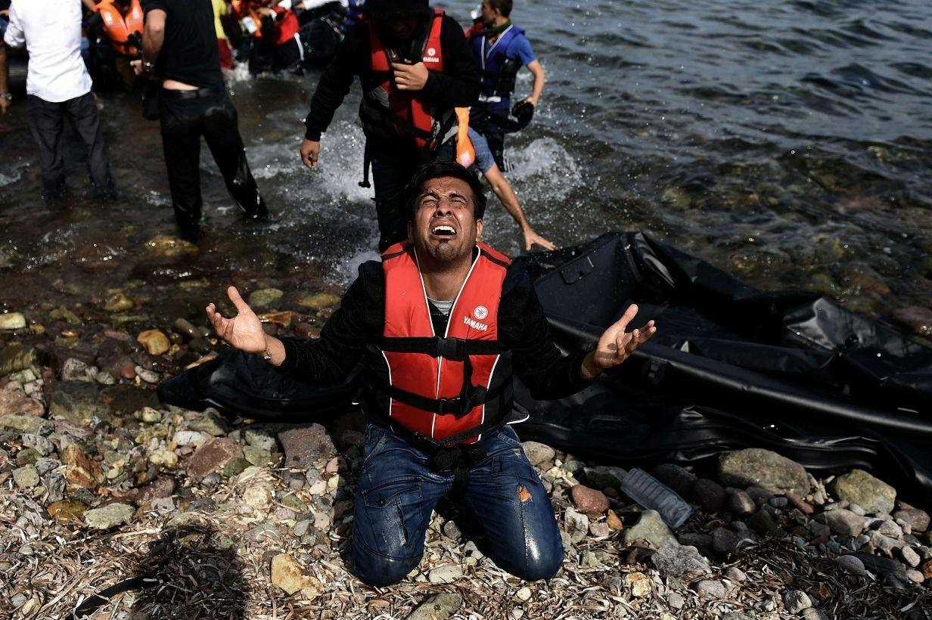
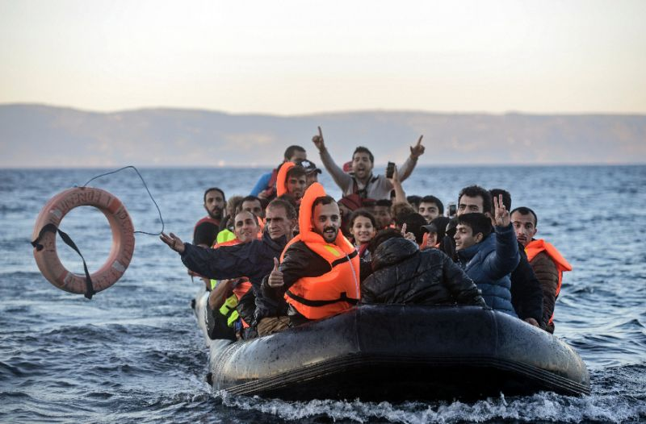
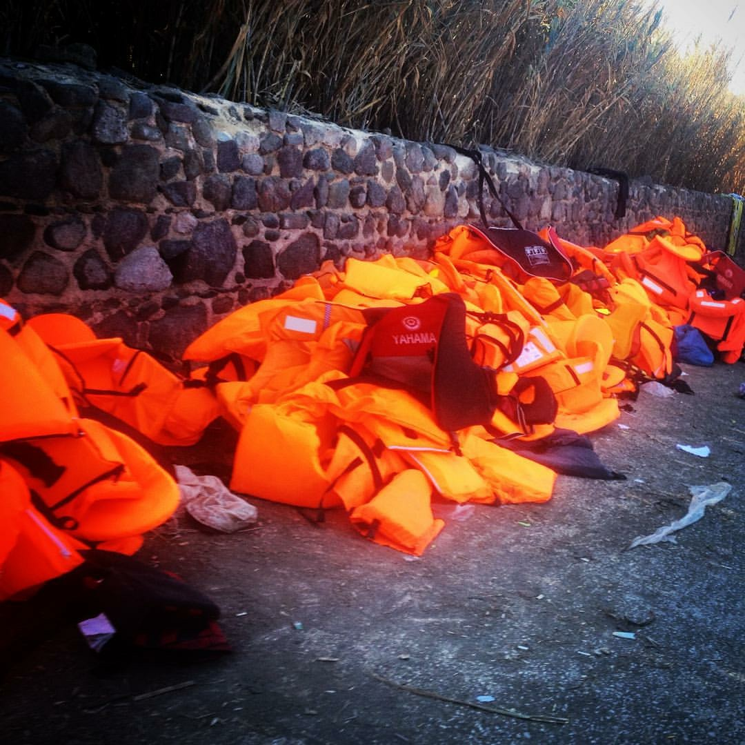
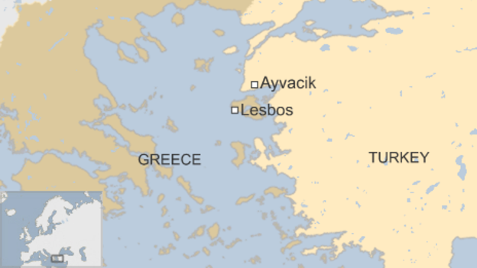

Slide 7
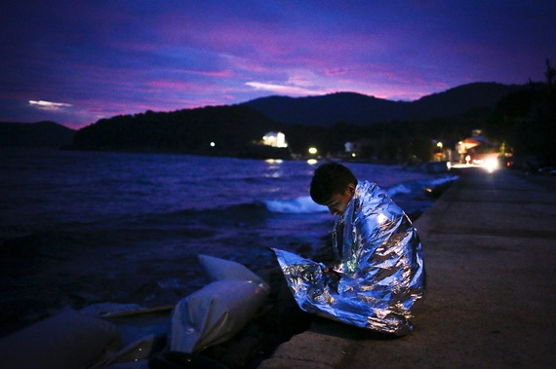

Slide 9
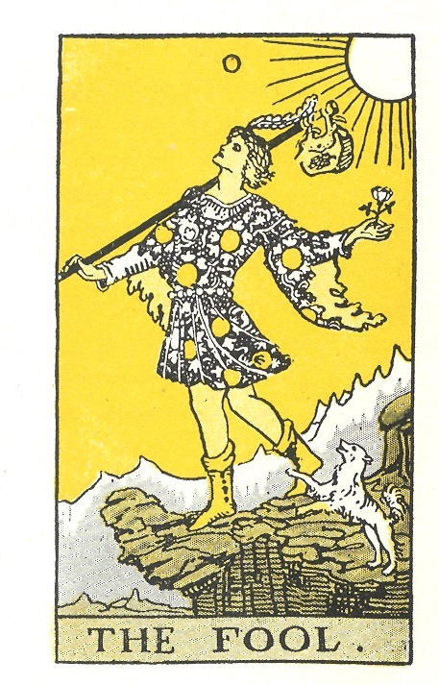
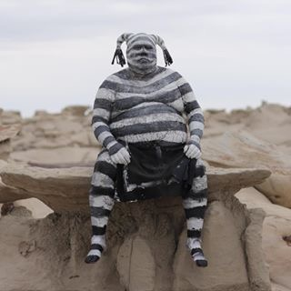
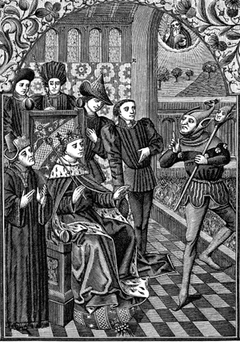
Fool card

Slide 10
“The only thing I know is that I know nothing”
–lots of smart guys

Slide 12
Important stuff in life

Slide 13
Important stuff in life
Food

Slide 14
Important stuff in life
Food
Shelter

Slide 15
Important stuff in life
Food
Shelter
Health

Slide 16
Important stuff in life
Food
Shelter
Health
Safty

Slide 17
Important stuff in life
Food
Shelter
Health
Safety
Comfort

Slide 18
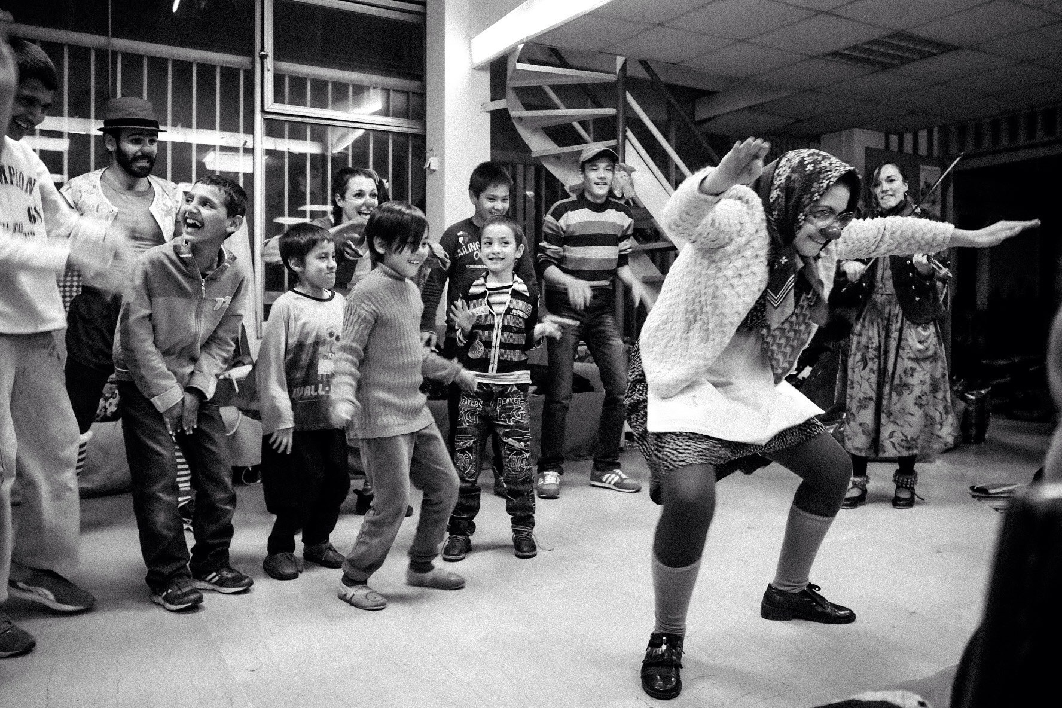
Joy!

Slide 20
Laughter
Increase endorphins
Relieve stress
Build community
Diminish pain

Slide 21
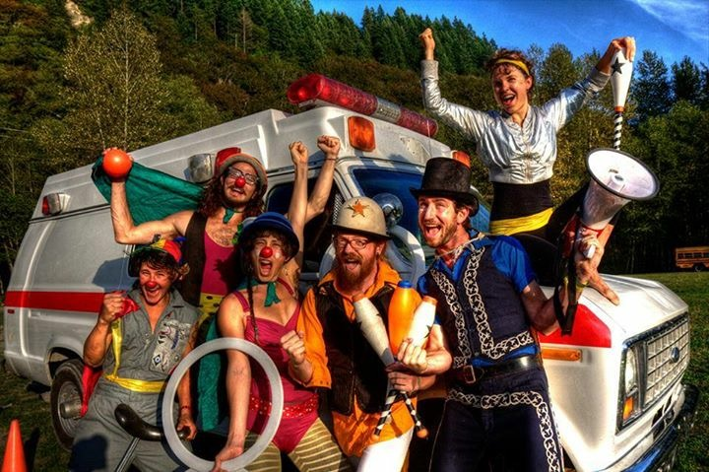
The emergency circus

Slide 22
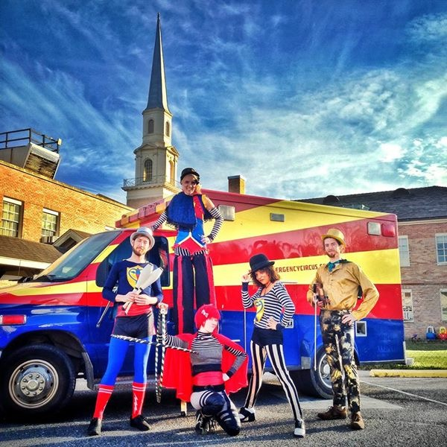
The emergency circus

Slide 23
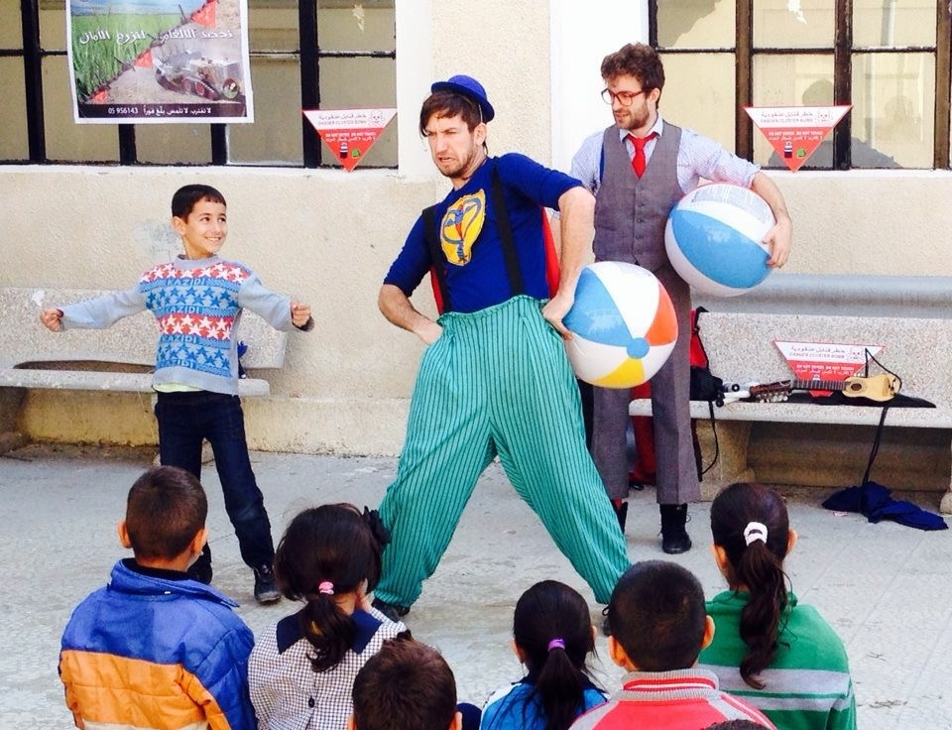

Slide 24
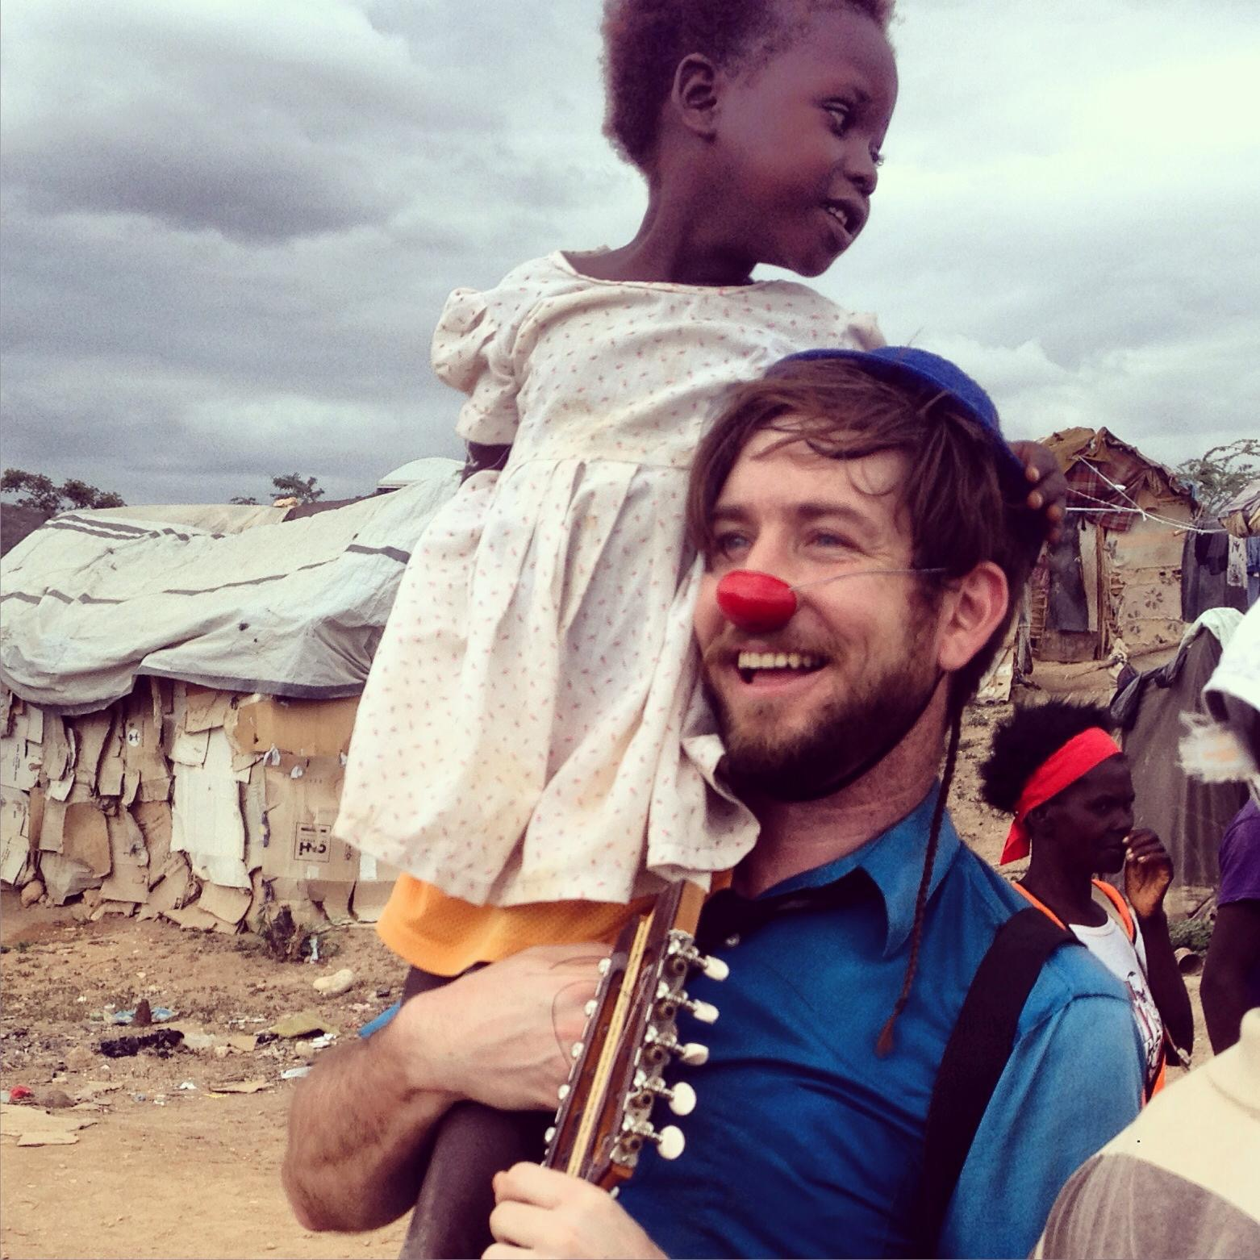
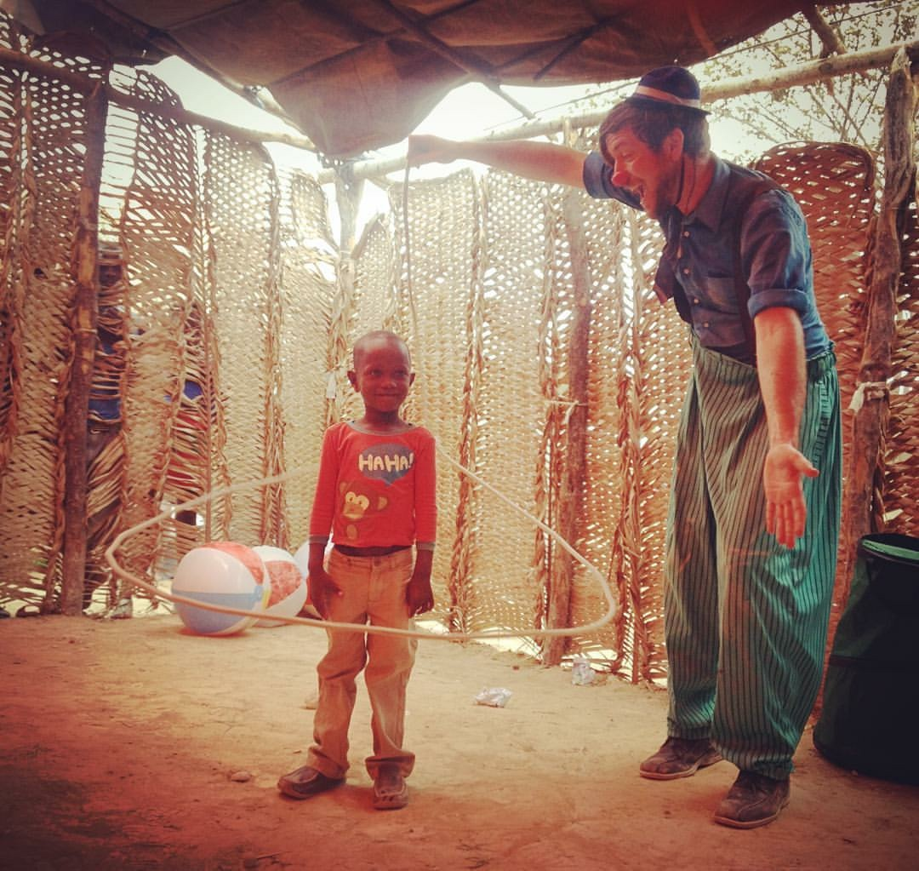
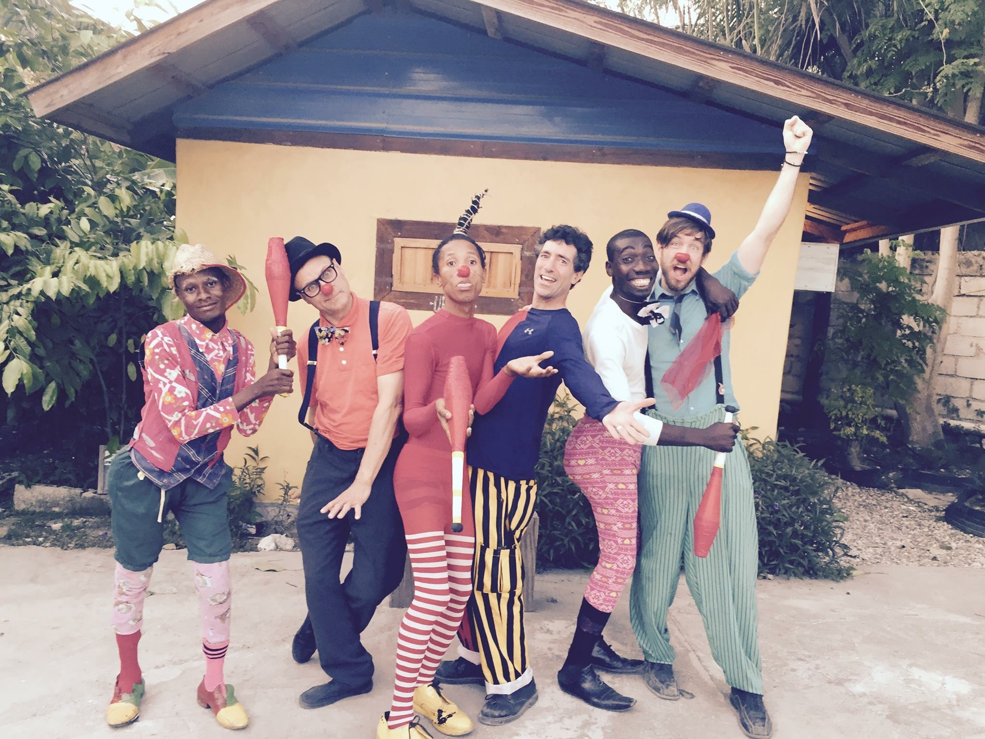

Slide 25
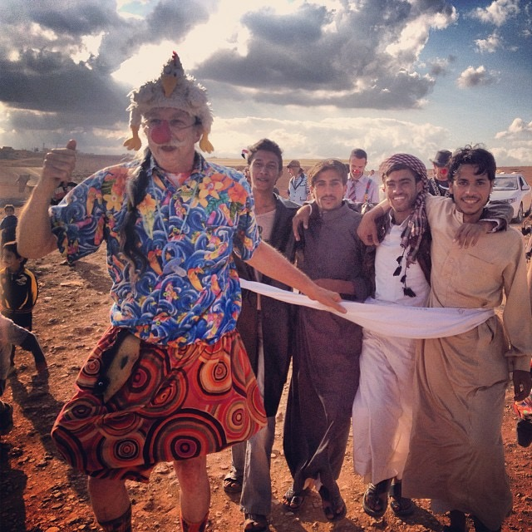

Slide 26
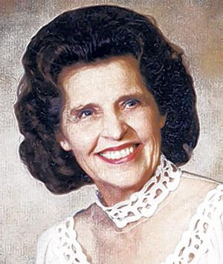

Slide 27
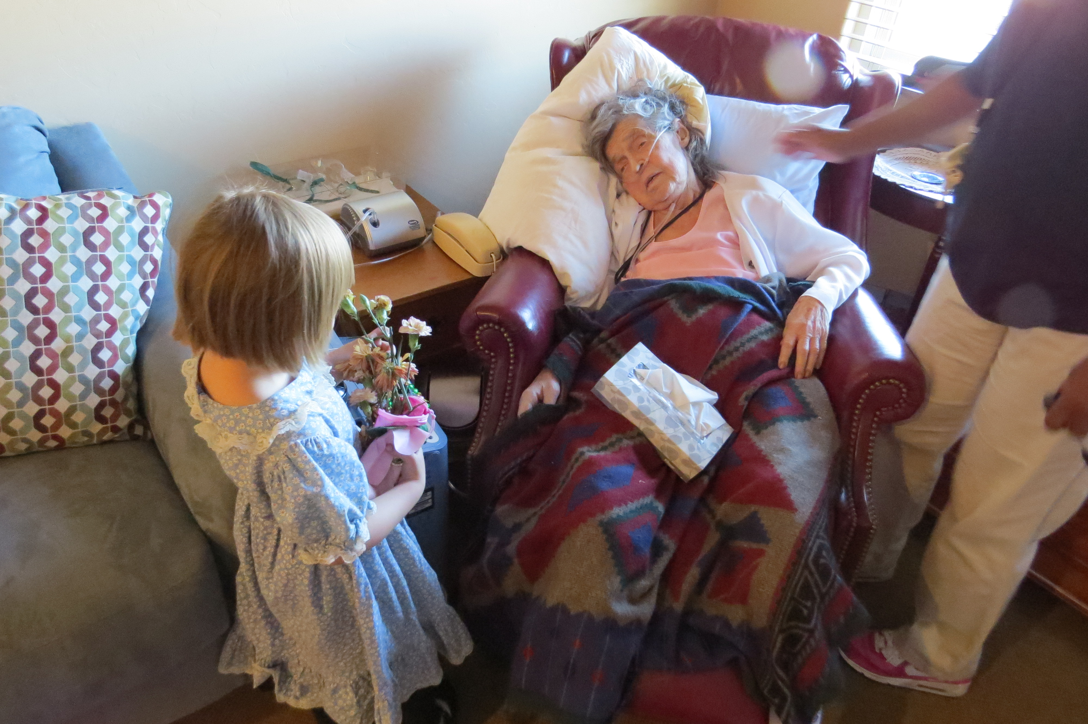
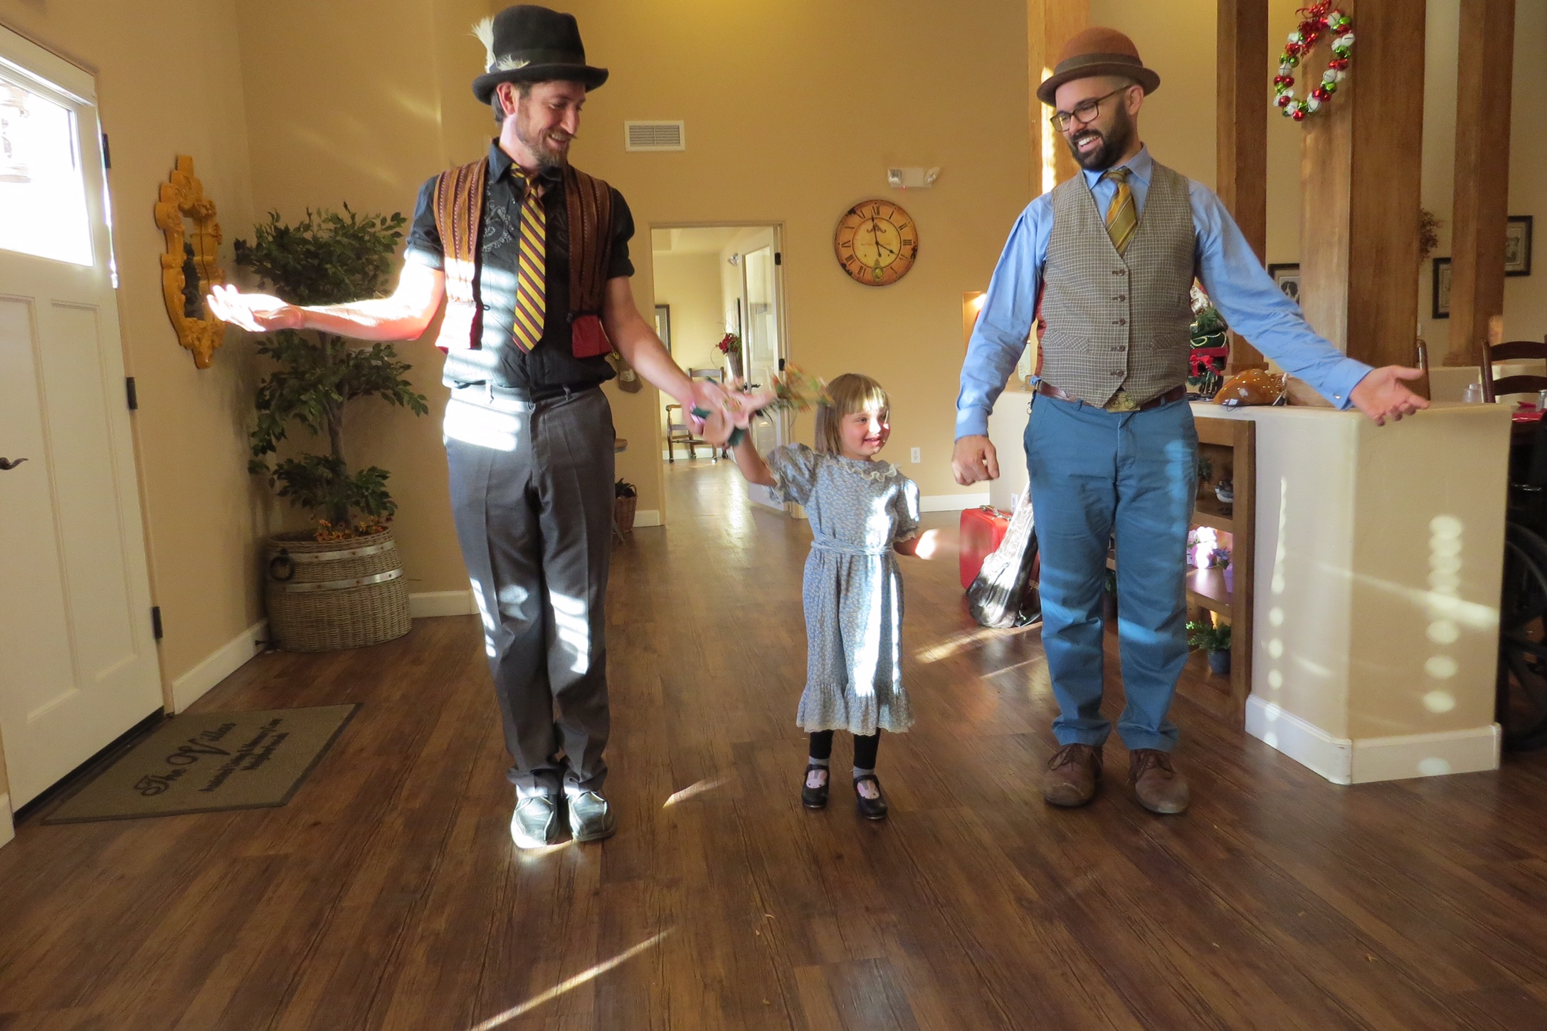
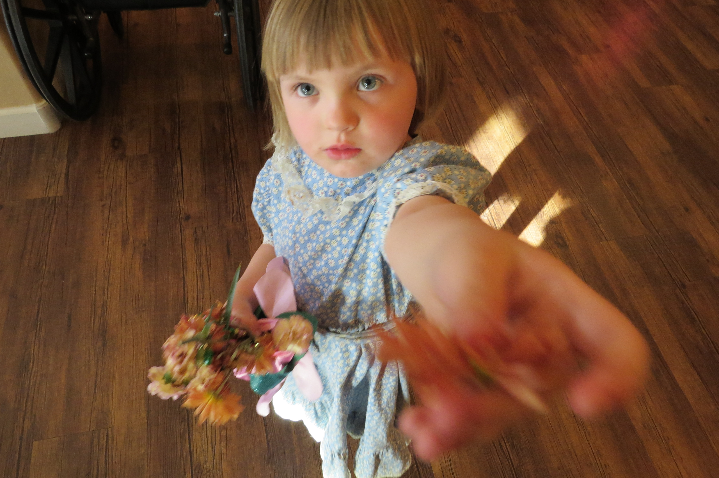
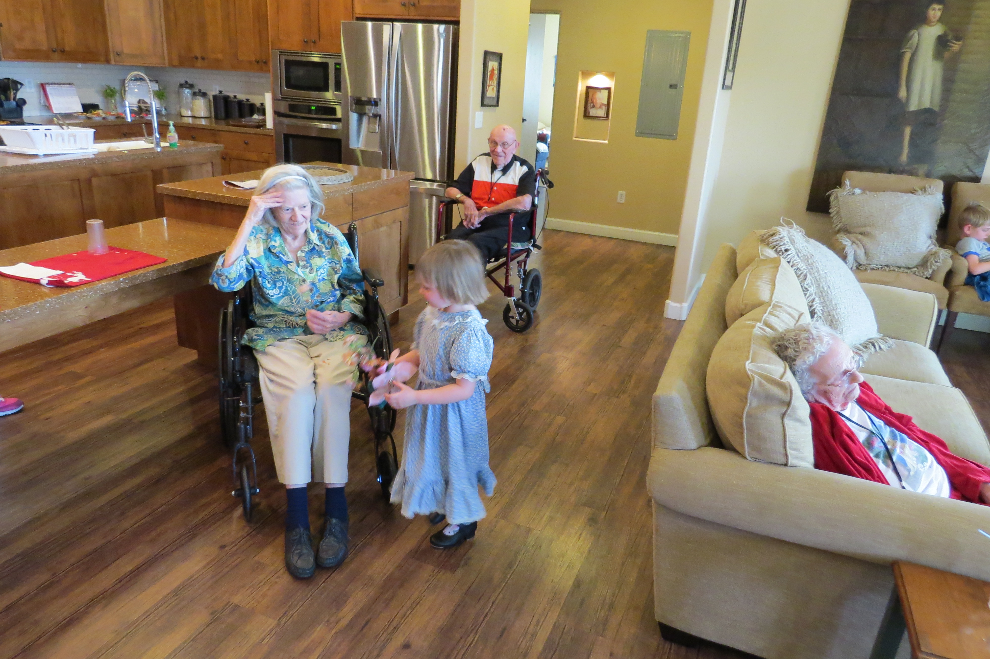

Slide 29
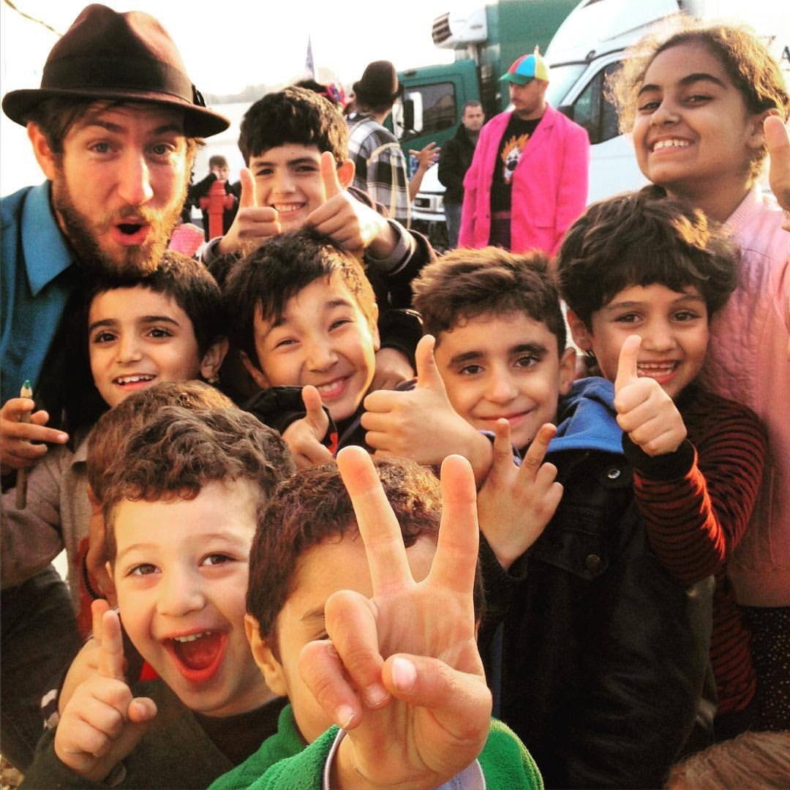
emergencycircus.com
Clay mazing

