Slide 1
PLAY is the PROPER PRESCRIPTION for WICKED PROBLEMS
Using play to create, share, mobilize knowledge to solve tough problems
Camilla Nørgaard Jensen | PhD candidate | Environmental Planning and Design
Notes:
I’m excited to share some of my research with you today. Together with my interdisciplinary research group I focus on how to create environments and processes that foster collaboration, creative problem solving and knowledge transfer.

Slide 2
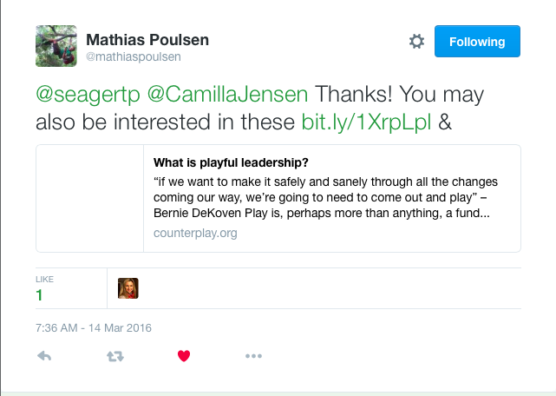
“If we want to make it safely through all of the changes coming our way, we’re going to need to come out and play”
Bernie DeKoven
Notes:
I’m here because Mathias convinced me through one of his tweets that you are my tribe m.
Because you believe that play will save the world!
Bernie DeKoven: “If we want to make it safely through all of the changes coming our way, we’re going to need to come out and play”

Slide 3
WHAT DOES THE WORLD NEED SAVING FROM?
Notes:
No seriously – what does the work need saving from?
If we pick up a newspaper…
Few minutes – you tell me what the world needs saving from – I’ll write it down.
What do they have in common? WICKED
They are consequences of problem solutions that stem from the industrial revolution.

Slide 4
Notes:
In fact, I’m gonna blame it all on this man
Frederick W. Taylor –
“One best way”
Made us rich
His methods cured disease, clean drinking water, make manufactured goods cheap and affordable.
He removed play from the work place.
Dehumanized the workers.

Slide 5
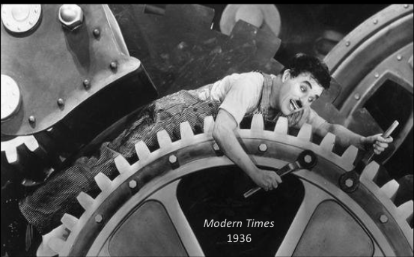
Notes:
Reduced ppl to mere cogs in the machinery.
These methods were GREAT for problems that have ONE right solution.

Slide 6
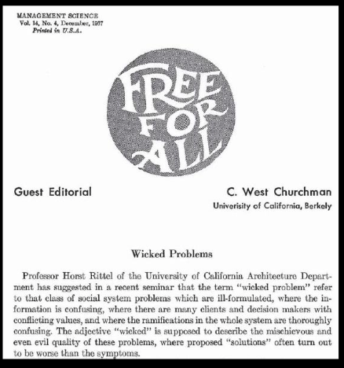
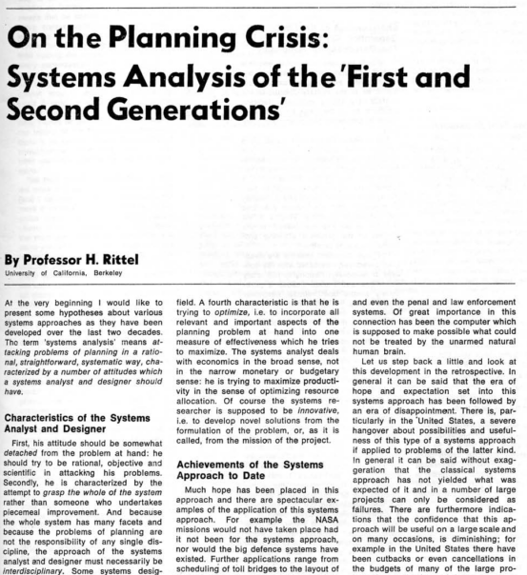
Notes:
The thing is the developed world does not have those problems anymore,
The problems you are telling me about are not reducable to one best way
They belong to another class of problems called wicked problems.
Rittel defined Wicked problems in the early 1970s
Complex problems – no clear problem definition
NEW APPROACHES to problem solving
Transdisciplinary – Creativity. Experimentation, adaptation, lateral thinking – iteration, incorporating lay knowledge. (multiple perspectives)

Slide 7
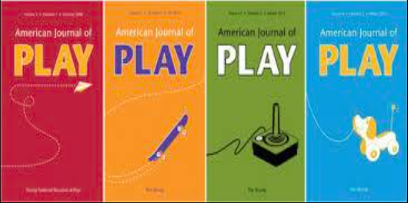
Notes:
All things that point to PLAY!

Slide 8
Play creates, shares, and mobilizes knowledge that can change the world
McCrystal et al, 2015
Notes:
Ironically, Taylor himself first conceived of his scientific management principles as a playful child,
free of the constraints he eventually imposed upon his own workers.
Jensen, Seager, Gushwan, Hinrichs 2016
(as reported in McChrystal et al. 2015)
So there is our proof that play can change the world.
All we need to know now is how.

Slide 9
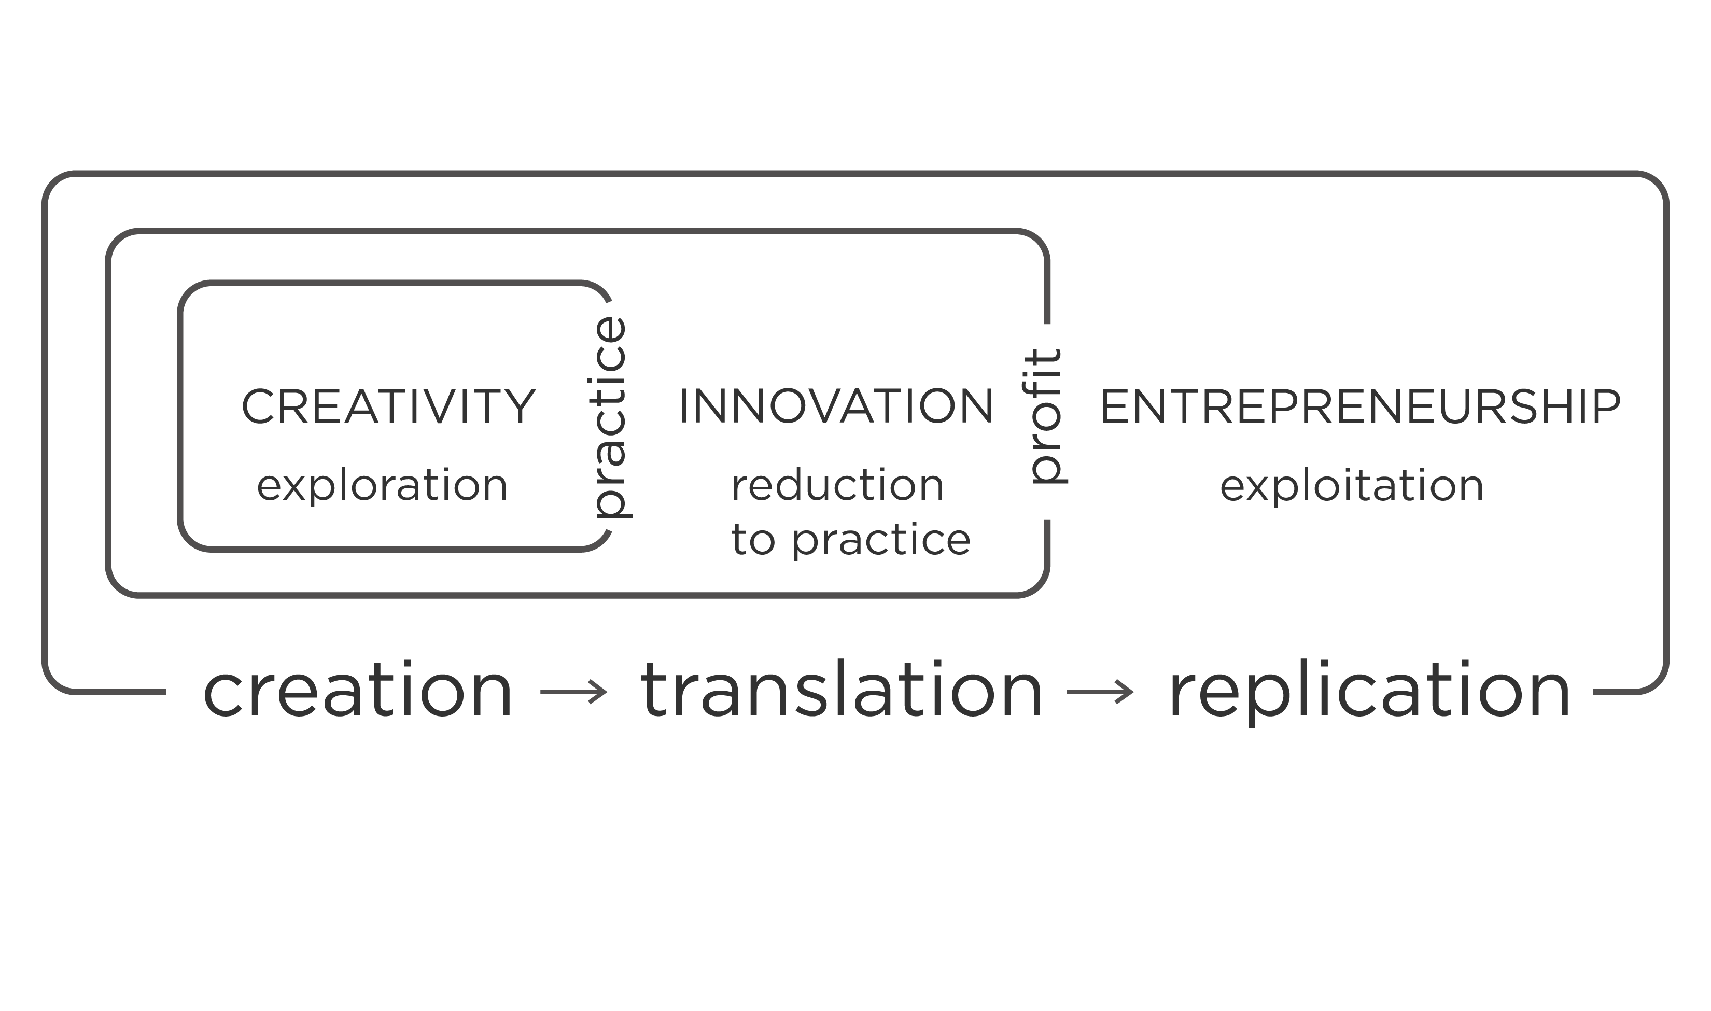
VALUE CREATION LIFE CYCLE
Figure 2 from: (Jensen, Hinrichs, Seager, Guschwan, 2016)
http://www.pubpub.org/pub/play-is-the-proper-prescription-for-entrepreneurship/
Notes:
The way you change the world is through entrepreneurship.

Slide 10
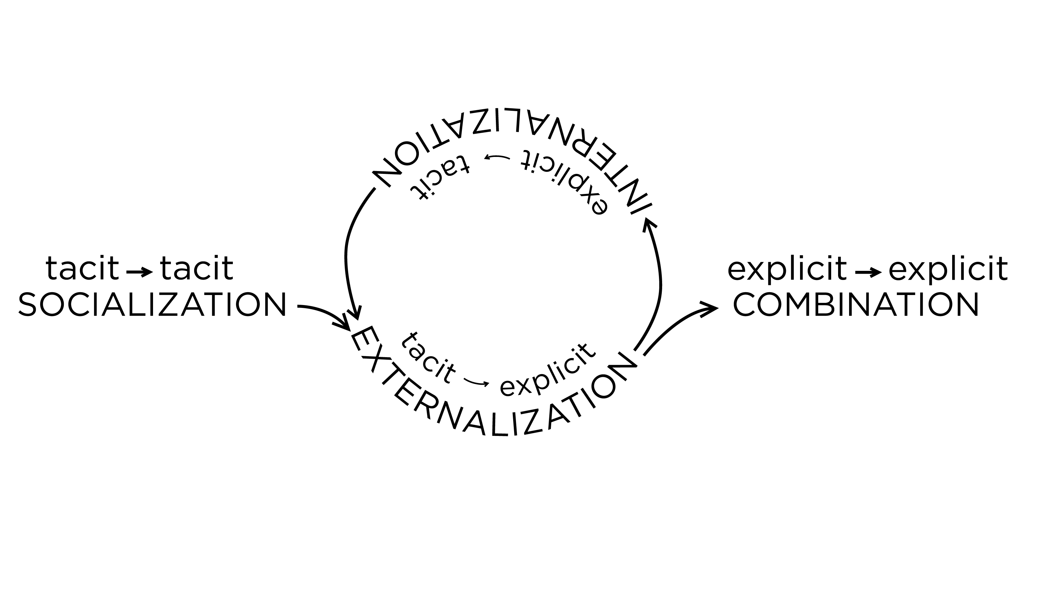
THE WHEEL OF KNOWLEDGE
Figure 4 from: (Jensen, Hinrichs, Seager, Guschwan, 2016)
http://www.pubpub.org/pub/play-is-the-proper-prescription-for-entrepreneurship/
Notes:
It is knowledge that changes the world.
CREATE SHARE AND MOBILIZE
tacit knowledge is in response to an implicit gap analysis – something that has to be solved. There is a problem in the world

Slide 11
CREATION
TRANSLATION
REPLICATION
EXPLORATION
CONVERSION/INTEGRATION
EXPLOITATION
SOCIALIZATION
EXTERNALIZATION/INTERNALIZATION
COMBINATION
Notes:
Play helps with all of these knowledge processes.
Play is essential to knowledge creation and translation, but must eventually yield to deliberate practice (which can be gamified) to ensure the exploitation of innovation in a profitable entrepreneurial venture.

Slide 12
Notes:
We need to know whch types of play to prescribe for which types of knowledge problems

Slide 13
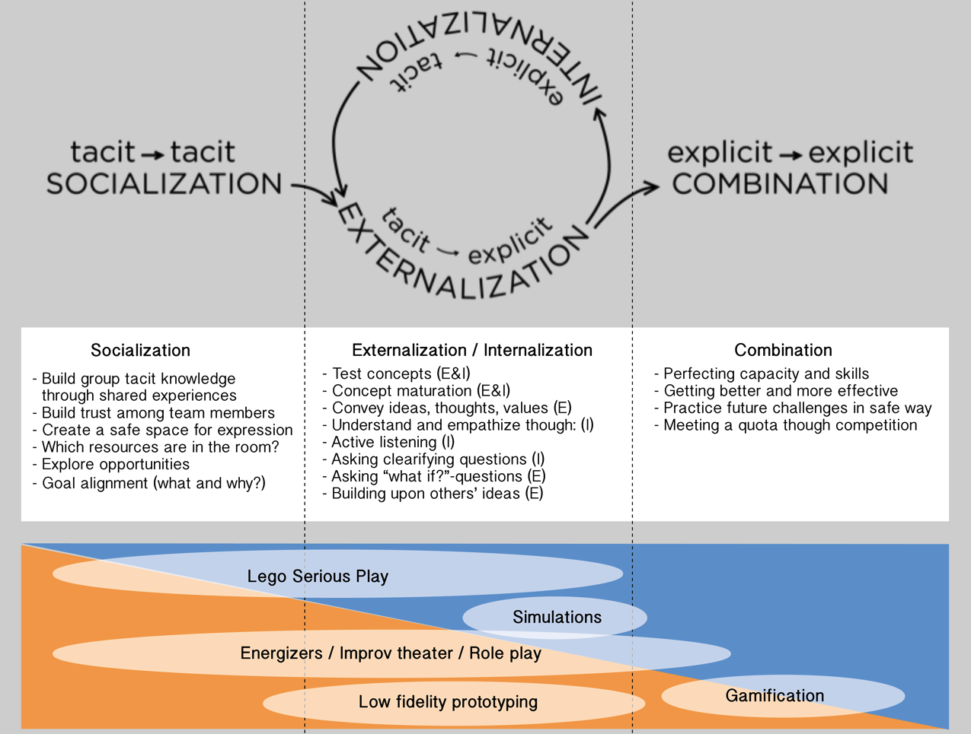

Slide 14
Notes:
SO how do we assess if play methods are effective.

Slide 15
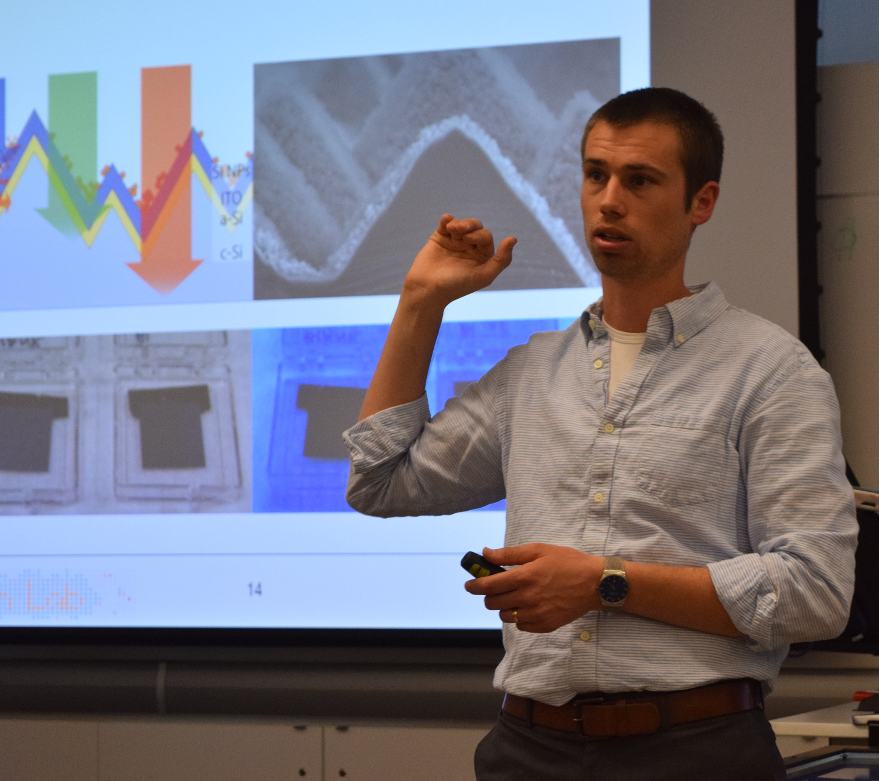

Slide 16
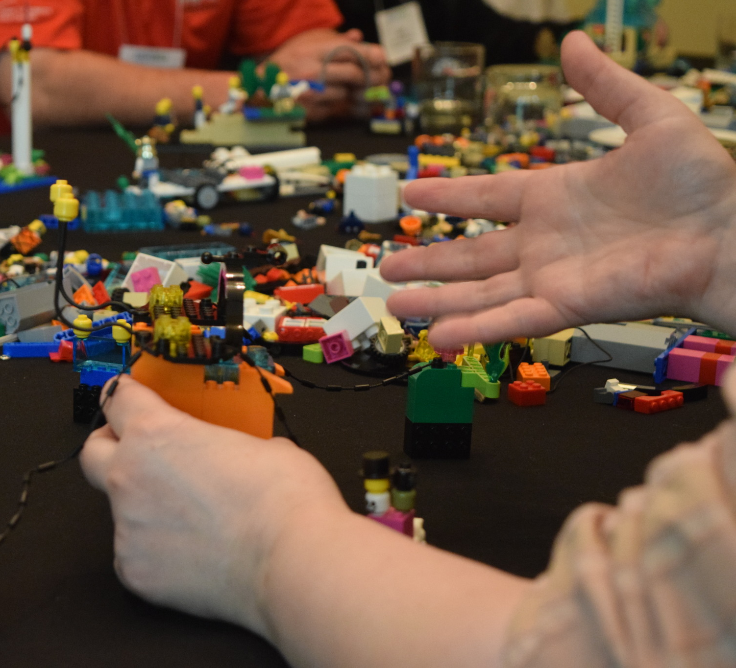

Slide 17
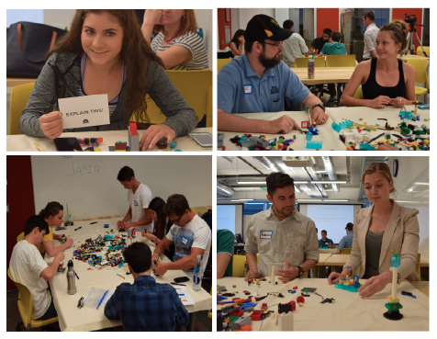

Slide 18
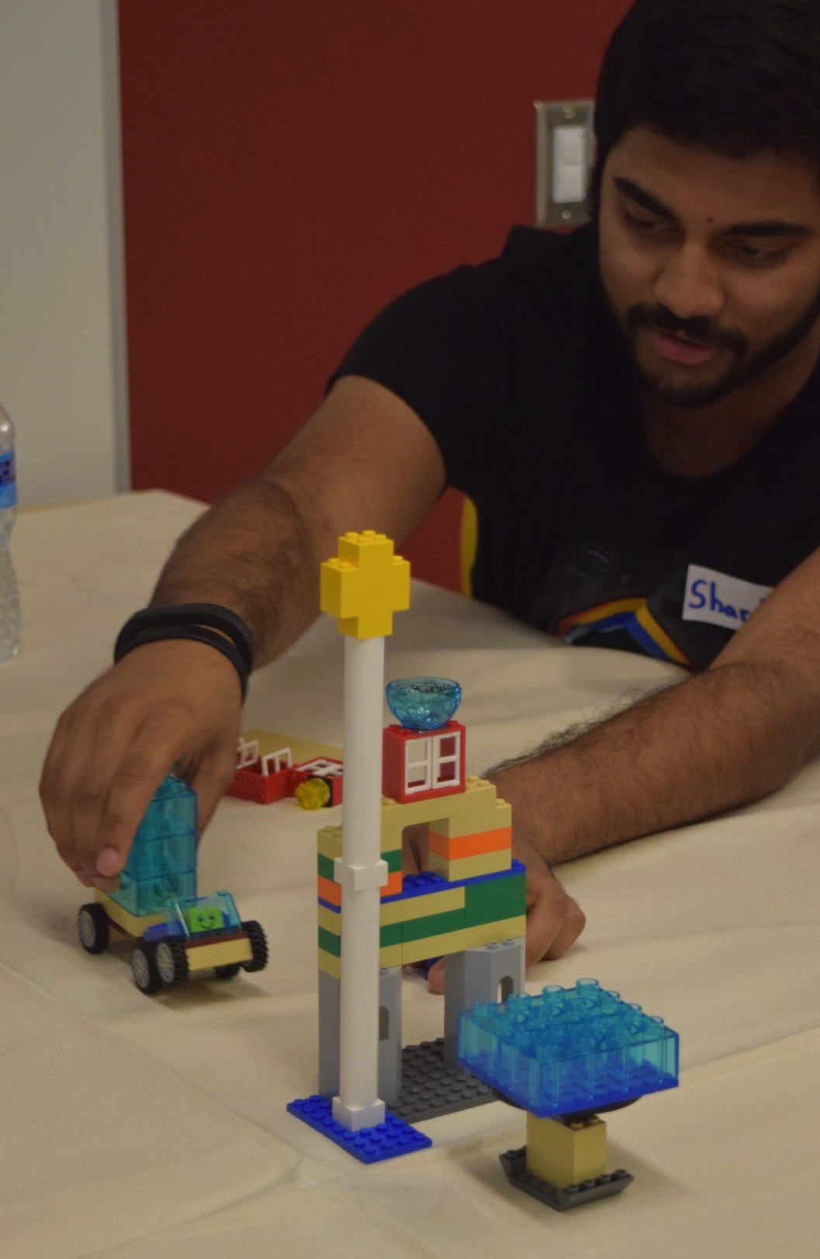
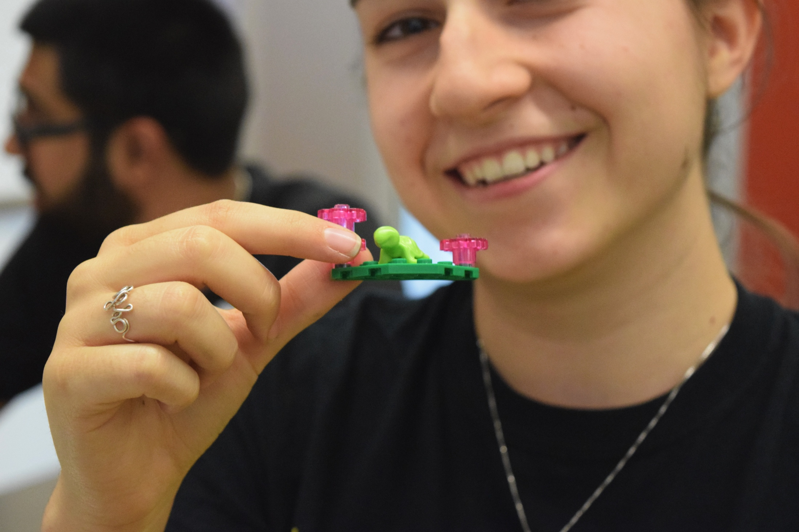
complex
LEGO® SERIOUS PLAY®
Data analysis
build₂
STORY
simple
complex
build₁
MODEL
simple

Slide 19
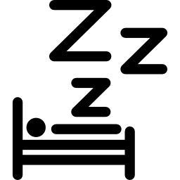
Self Actualization
Esteem
Belonging
Safety
Physiological
(Maslow, 1943)
Notes:
This way of assessing from simple to complex corresponds to the movement in maslow’s hierachy from the bottom to the top.
Talors methods are great for providing food shelter, basic necessities, but fail at addreessing the higher needs like selfacctualization.
Maslow himself recocnized play as the source of creativity. Game conference Chicago.
What we are doing at Counter play – the impression I get here is at you are working at the top of the pyramide – where ppl find a sense of purpose and belonging through play.

Slide 20
MY POST DOC (UMENTARY)
Notes:
Thinkering /play leads to scientific breakthroughs
new hypothesis about play as a way to transcend our inherent mode of operation and fuel creative & scientific breakthroughs.
Documentary movie about how play can:
foster scientific and creative breakthroughs
help people transcend their

Slide 21
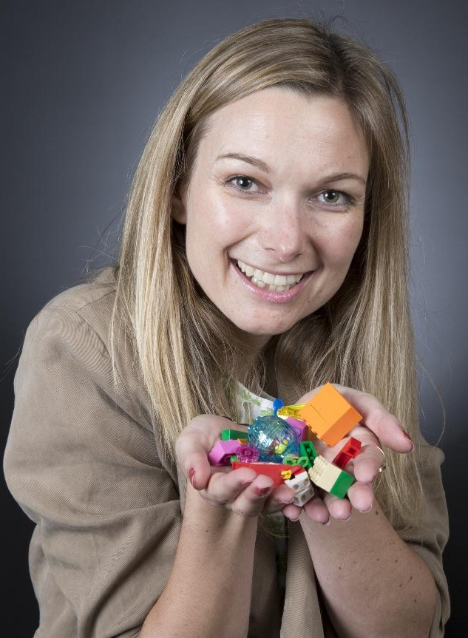
Camilla.jensen@asu.edu
@CamillaJensen
http://www.pubpub.org/pub/play-is-the-proper-prescription-for-entrepreneurship/

